Slide 1
UNO Lending Library
Tareq Alomar, Cody Barrett, Jacob Levy, Nick Volenec

Slide 2
Project Overview
The Lending Library lends out technology items to other institutions/teachers.
This process has no automation.
Our goals are as follows: - Automate the request process. - Allow renters to see what products are currently available. - Allow lenders to easily track inventory.
Stretch Goals: - Allow a new user to register via the web app. - Allow grouping of products into “modules” that can be placed into a renters “cart” with a single click.

Slide 3
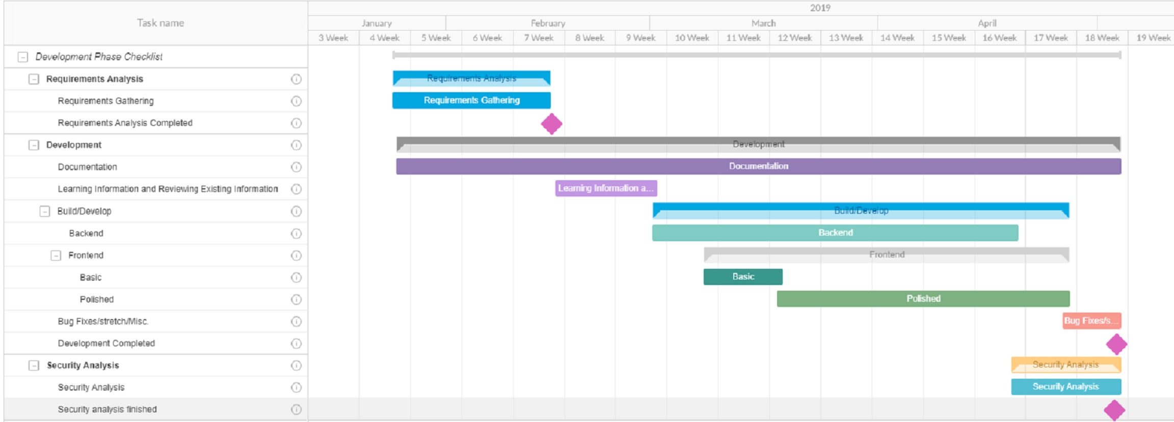
Project Timeline

Slide 4
Technology
Our solution will be built in a Django-Ember environment built on top of Docker with a PostgreSQL backend.
Docker is a platform for operating system level virtualization
Django is an open-source python based framework for rapid web development
Ember is an open-source javascript framework
PostgreSQL is an open-source Relational Database system

Slide 5
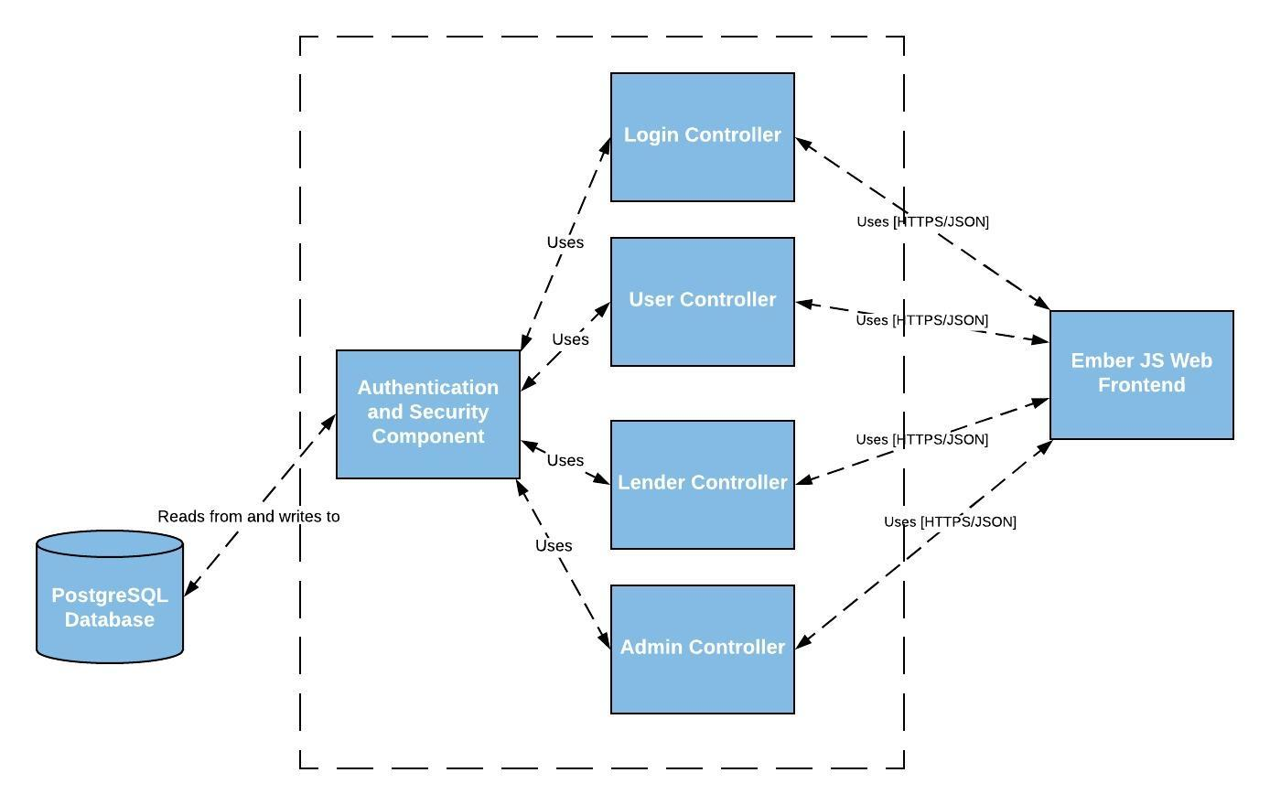
C4 Diagram - Level 3

Slide 6
Risk | Input | Likelihood
Illness of team member(s) | 4 | 4
Lack of Technical Proficiency | 3 | 4
Hardware Failure | 5 | 2
Inadequate Documentation | 4 | 1
Act of God | 8 | 1
Risk List

Slide 7
Security
Since this is a cybersecurity capstone project, one of our focuses is to create a system with robust security.
An initial list of security features we intend to implement:
CSRF tokens on all forms
A strict Content Security Policy to prevent code injection
All SQL queries will be built using prepared statements
Strong password policy
Robust access/activity logging
The JSON interface between the Django and Ember layers must be inaccessible to outside users

Slide 8
Questions?

